Slide 1

David M. Kroenke and David J. Auer Database Processing: Fundamentals, Design, and Implementation
Chapter One:
Introduction

Slide 2
Chapter Objectives
To understand the importance of databases in Internet Web applications and smartphone apps
To understand the nature and characteristics of databases
To survey some important and interesting database applications
To gain a general understanding of tables and relationships
To describe the components of a Microsoft Access database system and explain the functions they perform
To describe the components of an enterprise-class database system and explain the functions they perform

Slide 3
Chapter Objectives
To define the term database management system (DBMS) and describe the functions of a DBMS
To define the term database and describe what is contained within the database
To define the term metadata and provide examples of metadata
To define and understand database design from existing data
To define and understand database design as new systems development
To define and understand database design in database redesign

Slide 4
Chapter Objectives
To understand the history and development of database processing

Slide 5
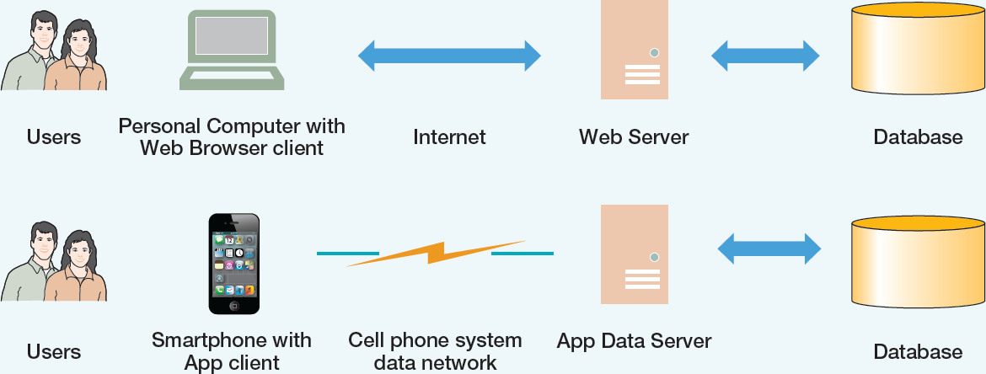
The Internet and Mobile Device World Client-Server Architecture
Notes:
The use of databases by Web applications and smartphone apps is illustrated here. In this figure, people have computers (desktop or notebook) and smartphones, which are examples of devices used by people, who are referred to as users. On these devices are client applications (Web browsers, apps) used by people to obtain services such are searching, browsing, on-line purchasing, and tweeting over the Internet or cell phone networks. These services are provided by server computers, and these are the computers that hold the databases containing the data needed by the client applications.
This structure is known as client-server architecture, and it supports most of the Web applications in use today.

Slide 6
Databases in the Internet and Mobile Device World
Databases are important because they are everywhere and are used daily:
Facebook
Posts
Likes
Twitter
Tweets
Online shopping
Amazon.com - [Do an actual search]
Notes:
The simple fact is that without databases, we could not have the ubiquitous Web applications and apps that are currently used by so many people.
It is much more effective to see this process then to just read about it. Take a minute, open a Web browser and go to Amazon.com (or any other online retailer, such as Best Buy, Crutchfield, or REI). Search for something you are interested in, and watch the database search results be displayed for you. You just used a database.

Slide 7
How Did We Get Here? The Internet World I
Personal Computers
1977: Apple II
1981: IBM PC
Local Area Networks
Ethernet networking technology
Early 1970s: Xerox Palo Alto Research Center
1893: US National Standard
Notes:
The Personal Computer (PC) became widely available with the introduction of the Apple II in 1977 and the IBM Personal Computer (IBM PC) in 1981. PCs were networked into Local Area Networks (LANs) using the Ethernet networking technology which was developed at the Xerox Palo Alto Research Center in the early 1970’s and adopted as a national standard in 1983.

Slide 8
How Did We Get Here? The Internet World II
The Internet
1969: ARPANET
World Wide Web (WWW)
1993: First Web browser (Netscape) available
Mid 1990’s: Online retail sites
1995: Amazon.com
Early 2000’s: Web 2.0
Notes:
The Internet—the global computer network of networks—was created as the ARPANET in 1969, and then grew and was used to connect all the LANs (and other types of networks).
The Internet became widely known and used when the World Wide Web (also referred to as the Web and WWW) became easily accessible in 1993.
Everyone got a computer software application called a Web browser and starting browsing to Web sites.
Online retail Web sites such as Amazon.com (online since 1995) and “brick-and-mortar” stores with an online presence such as Best Buy appeared, and people started extensively shopping online.
In the early 2000s, Web 2.0 Web sites started to appear—Web sites that allowed users to add content to Web sites that had previously held static content. Web applications such as Facebook, Wikipedia, and Twitter appeared and flourished.

Slide 9
How Did We Get Here? The Smartphone World
Mid 1970s: Mobile Phone (Cell Phone)
Smartphone
2007: Apple iPhone
2008: Google Android Operating System
Tablets
2010: Apple iPad
Apps
Notes:
In a parallel development, the mobile phone or cell phone was demonstrated and developed for commercial use in the 1970s.
After decades of mobile phone and cell phone network infrastructure development, the smartphone appeared.
Apple brought out the iPhone in 2007. Google created the Android operating system, and the first Android based smartphone entered the market in 2008.
Seven years later, in 2015, smartphones and tablet computers (tablets) are widely used, and thousands of application programs known as apps are widely available and in daily use.
Most Web applications now have corresponding smartphone and tablet apps (you can “tweet” from either your computer or your smartphone)!

Slide 10
The Characteristics of Databases
The purpose of a database is to help people track things of interest to them.
Data is stored in tables, which have rows and columns like a spreadsheet. A database may have multiple tables, where each table stores data about a different thing.
Each row in a table stores data about an occurrence or instance of the thing of interest.
A database stores data and relationships.

Slide 11
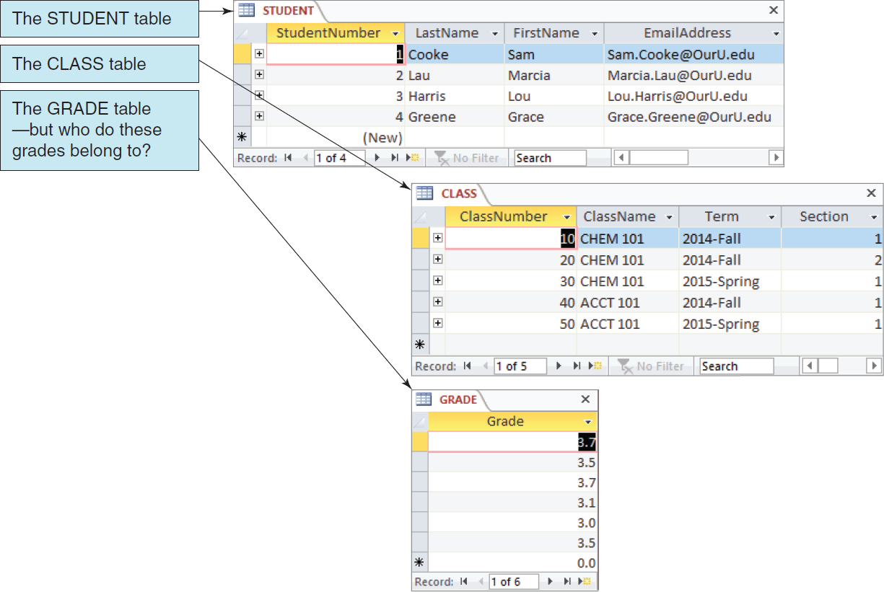
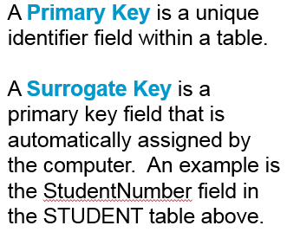
Data in Tables
Notes:
Note: Harold Wise of East Carolina University contributed material for this slide.

Slide 12
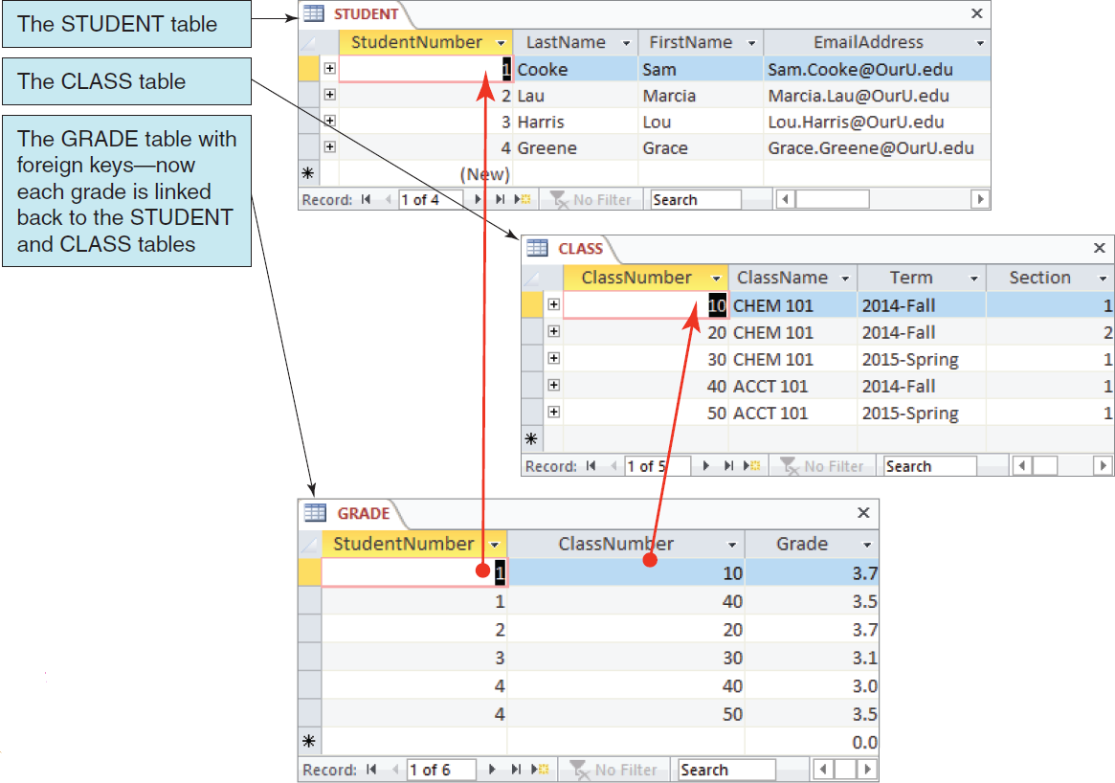
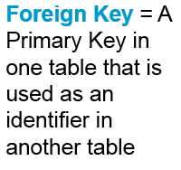
The Key Characteristic of Databases: Related Tables
A Composite Key is a primary key that consists of 2 or more attributes that uniquely identify an entity occurrence.
Notes:
Note: Harold Wise of East Carolina University contributed material for this slide.

Slide 13
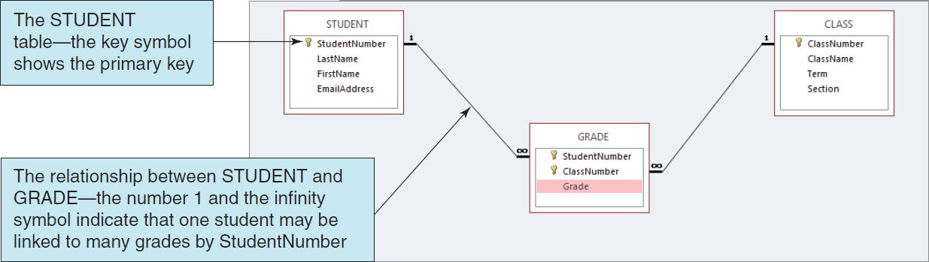
Microsoft Access 2013 Tables and Relationships

Slide 14
Naming Conventions in this Textbook
Table names are written with all capital letters:
STUDENT, CLASS, GRADE, COURSE_INFO
Column names are written with an initial capital letter, and compound names are written with a capital letter on each word:
Term, Section, ClassNumber, StudentName
Notes:
Note: Harold Wise of East Carolina University contributed material for this slide.

Slide 15
Databases Create Information
Data = recorded facts and figures
Information = knowledge derived from data
Databases record data, but they do so in such a way that we can produce information from the data.
The data on STUDENTs, CLASSes, and GRADEs could produce information about each student’s GPA.

Slide 16
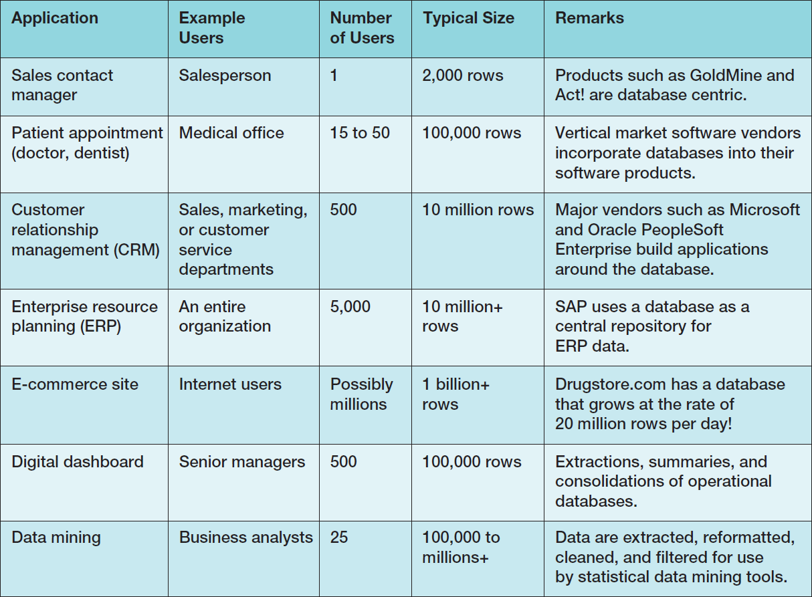
Database Examples

Slide 17
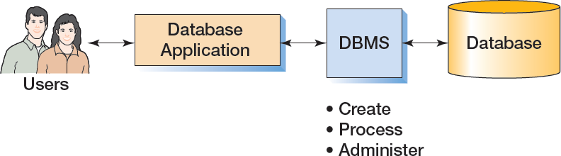
Components of a Database System

Slide 18
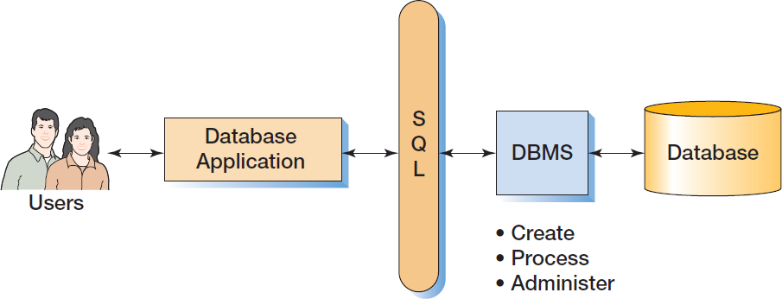
Components of a Database System with SQL

Slide 19
Applications, the DBMS, and SQL
Applications are the computer programs that users work with.
The Database Management System (DBMS) creates, processes, and administers databases.
Structured Query Language (SQL) is an internationally recognized standard database language that is used by all commercial DBMSs.

Slide 20
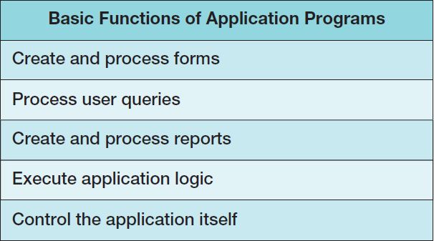
Database Applications

Slide 21
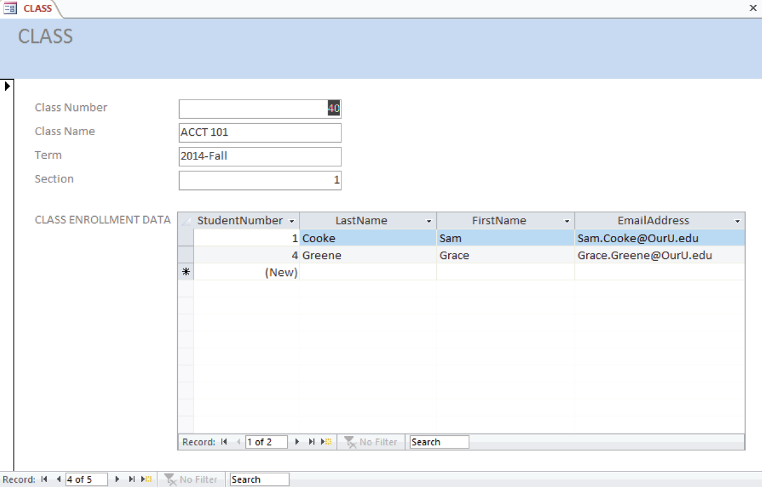
Database Applications—Forms

Slide 22
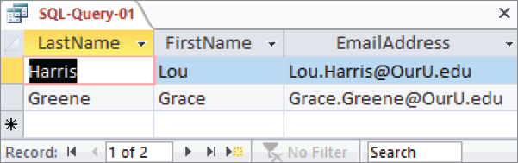
Database Applications—Queries
SELECT LastName, FirstName, EmailAddress
FROM STUDENT
WHERE StudentNumber > 2;

Slide 23
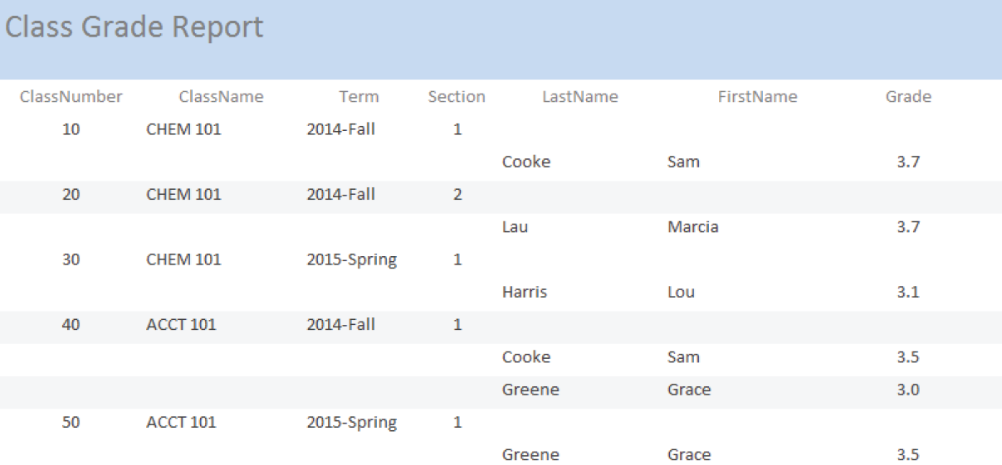
Database—Reports

Slide 24
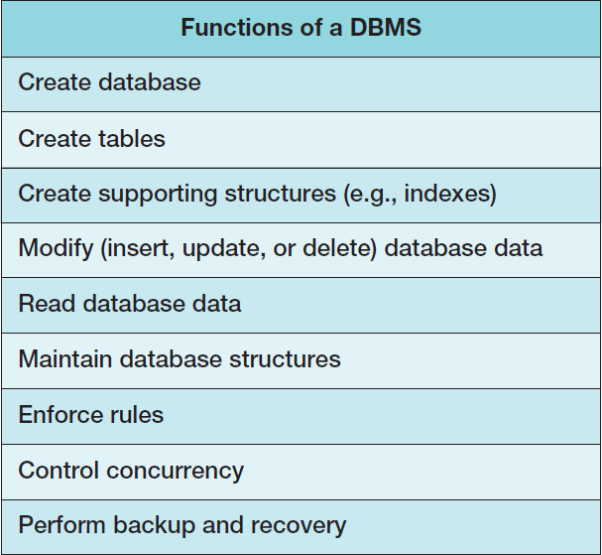
The DBMS

Slide 25
The Database
A database is a self-describing collection of integrated tables.
The tables are called integrated because they store data about the relationships between the rows of data.
A database is called self-describing because it stores a description of itself.
The self-describing data is called metadata, which is data about data.

Slide 26
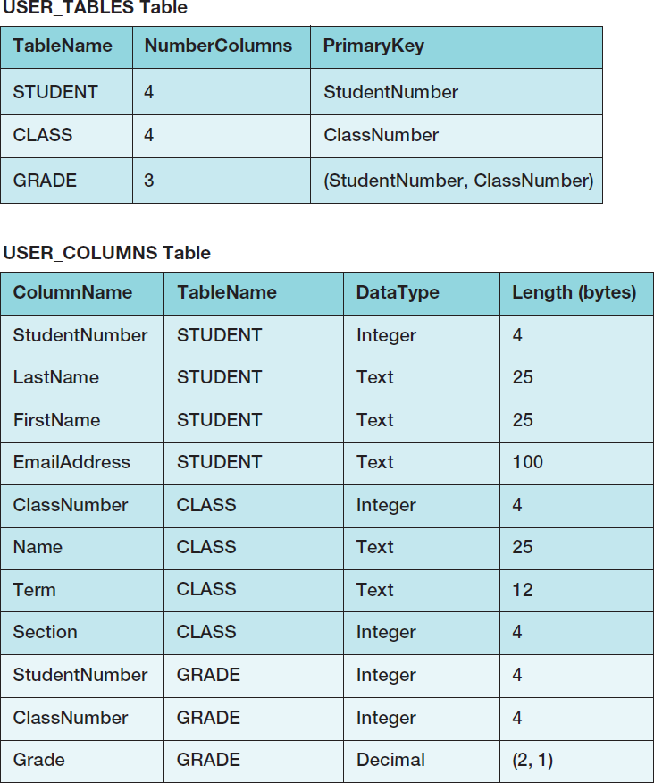
Typical Metadata Tables

Slide 27
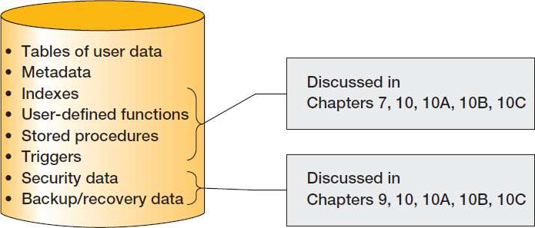
Database Contents

Slide 28
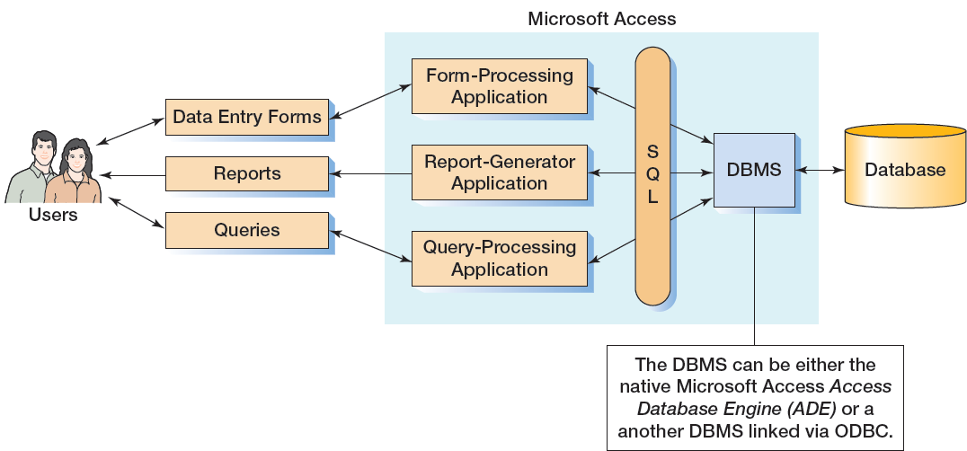
Personal Database Systems: Microsoft Access

Slide 29
Microsoft Access
Microsoft Access is a low-end product intended for individual users and small workgroups.
Microsoft Access tries to hide much of the underlying database technology from the user.
A good strategy for beginners, but not for database professionals.
NOTE: Microsoft Access 2013 is discussed in detail in Appendix A.

Slide 30
What Is Microsoft Access?
Microsoft Access is a DBMS plus an application generator:
The DBMS creates, processes, and administers Microsoft Access databases.
The application generator includes query, form, and report components.
The Microsoft Access DBMS engine is called the Access Data Engine (ADE).
Microsoft Access 2000 thru 2010 can be used as an application generator for the Microsoft SQL Server DBMS.

Slide 31
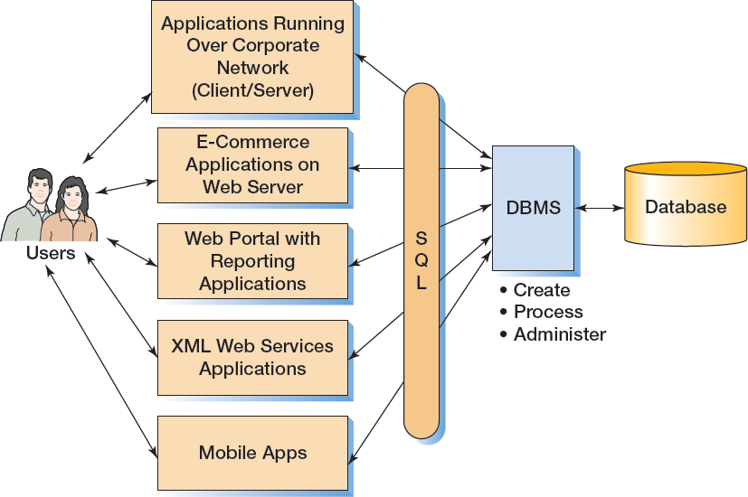
Enterprise-Class Database Systems

Slide 32
Prominent DBMS Products
Microsoft Access 2013
Microsoft SQL Server 2014
Microsoft SQL Server 2014 Express
Oracle Corporation Oracle Database 12c
Oracle Database Express Edition 11g Release 2
MySQL 5.6
IBM DB2

Slide 33
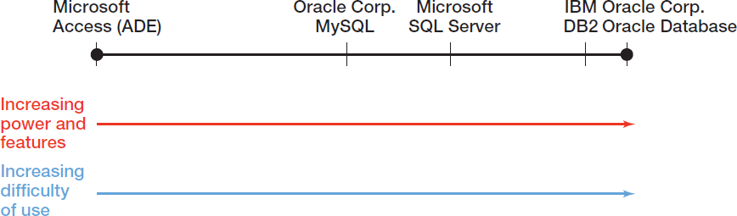
DBMS Power vs. Ease of Use

Slide 34
Operating System (OS)
Microsoft Windows
Microsoft Access 2013
Microsoft SQL Server 2014
Oracle Database
MySQL 5.6
Linux
Oracle Database
MySQL
Apple OS X
MySQL 5.6
Notes:
DBMS products, whether on a personal computer or a server, do not simply run by themselves. Like all other applications, they require that the computer have an operating system (OS) installed to handle the basic system operations (writing and reading files, printing, and so on).
Therefore, when you are selecting a DBMS product, you must be aware of which OS will support the use of that product. Today, the main OS products are Microsoft Windows (for desktop and notebook computers), Microsoft Windows Server (for servers), Apple OS X for Mac (previously MacIntosh) desktops and notebooks, and various versions of Linux (notable for the shareware development environment of the product).
Microsoft DBMS products (Microsoft Access and Microsoft SQL Server) run only on Microsoft operating systems. Oracle Database products will run on both the Windows OS and the Linux OS but not on Apple OS X. MySQL is the only DBMS product that runs on all of the three operating systems.

Slide 35
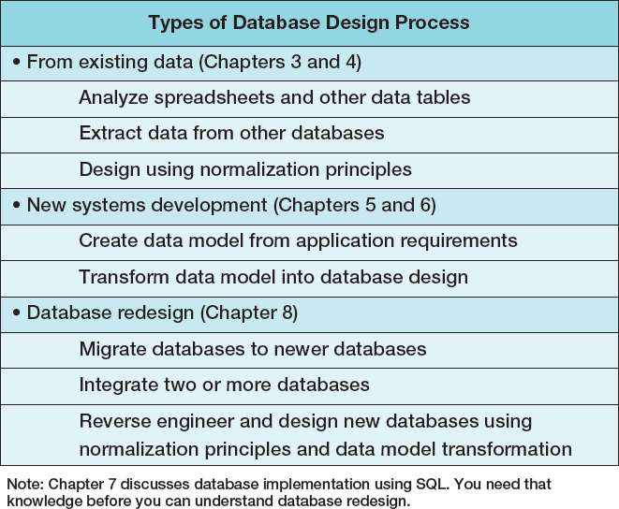
Three Types of Database Design

Slide 36
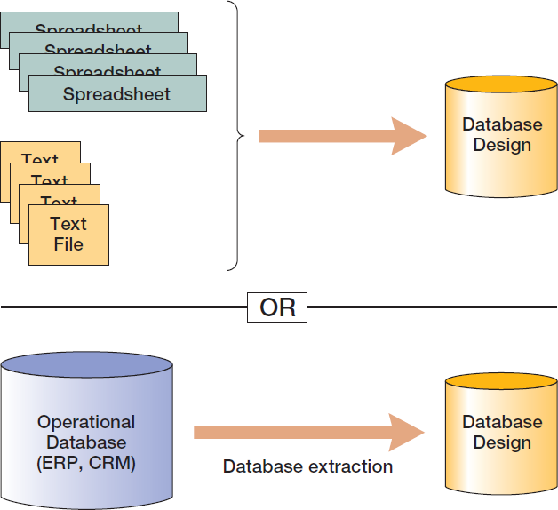
Database Design from Existing Data

Slide 37
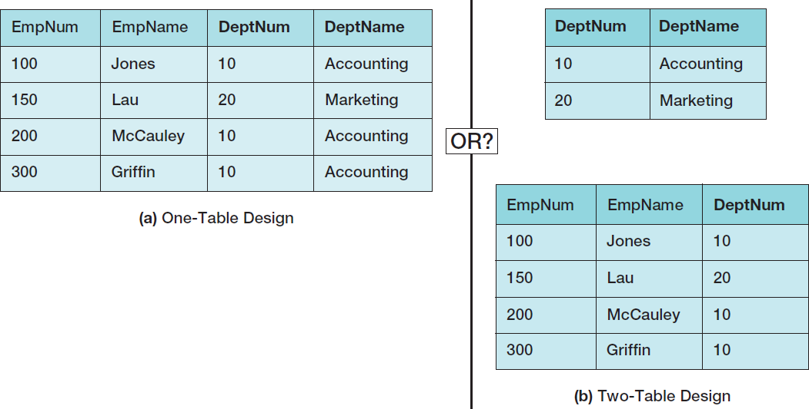
Data Import: One or Two Tables?
This is an important decision, and based on a set of rules known as normalization (which is covered in Chapter 3).

Slide 38
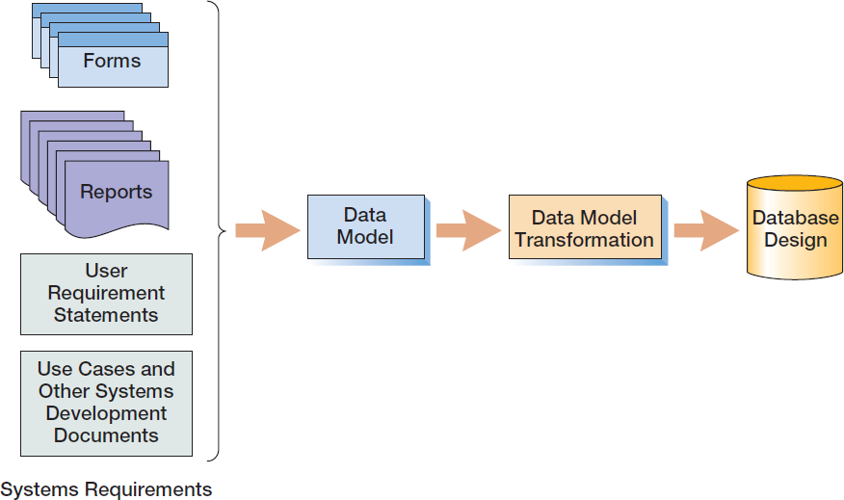
Database Design from New Systems Development
Entity-Relationship data modeling is covered in Chapter 5, and data model transformations to database designs are covered in Chapter 6.

Slide 39
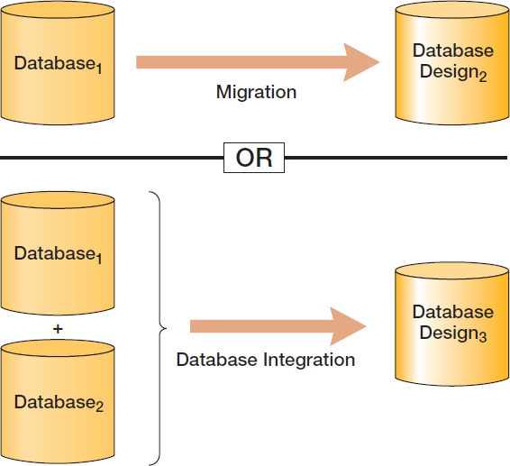
Database Design from Database Redesign
Database redesign is covered in Chapter 8, after coverage of SQL in Chapter 7.

Slide 40
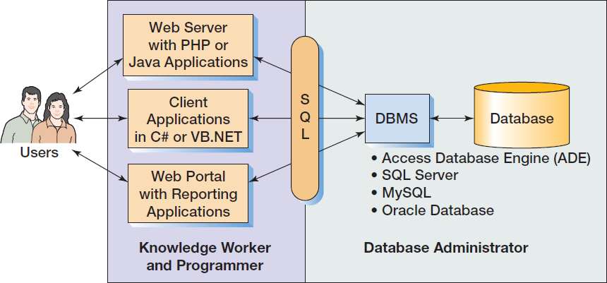
What You Need To Learn

Slide 41
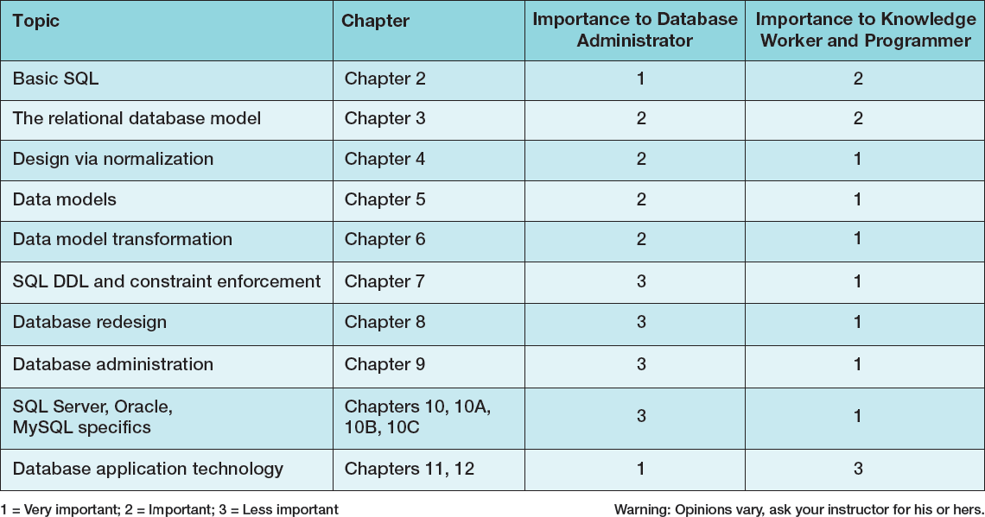
Knowledge Priorities

Slide 42
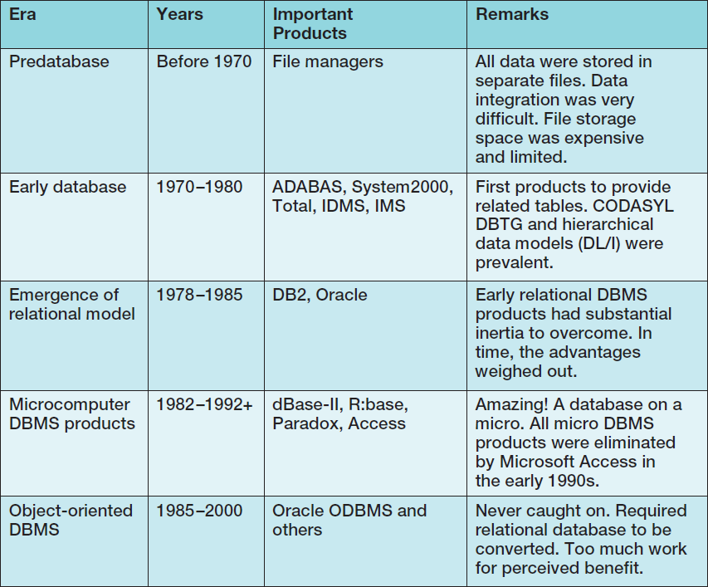
A Brief History of Database Processing I

Slide 43
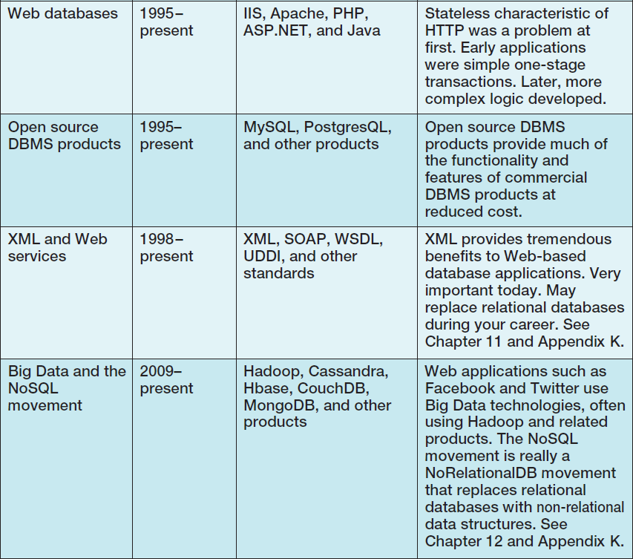
A Brief History of Database Processing II

Slide 44
The Relational Database Model
The dominant database model is the relational database model—all current major DBMS products are based on it.
It was created by IBM engineer E. F. Codd in 1970.
It was based on mathematics called relational algebra.
This text examines and explains the relational database model.

Slide 45
The NoSQL Movement and Big Data
Recent developments in Internet and mobile computing have resulted in the development of non-relational DBMSs.
NoSQL movement
Big Data
These do not replace the relational model, but rather complement it.
These topics are discussed in Chapter 12 and Appendix K.

Slide 46
David Kroenke and David Auer Database Processing Fundamentals, Design, and Implementation (14th Edition)
End of Presentation:
Chapter One

Slide 47

All rights reserved. No part of this publication may be reproduced, stored in a retrieval system, or transmitted, in any form or by any means, electronic, mechanical, photocopying, recording, or otherwise, without the prior written permission of the publisher. Printed in the United States of America.

